Slide 1

Shop for me
Online Retail store
2018 Online Store Sales & Performance Insights - Summary of Sales, Profit, and Consumer Behavior

Slide 2
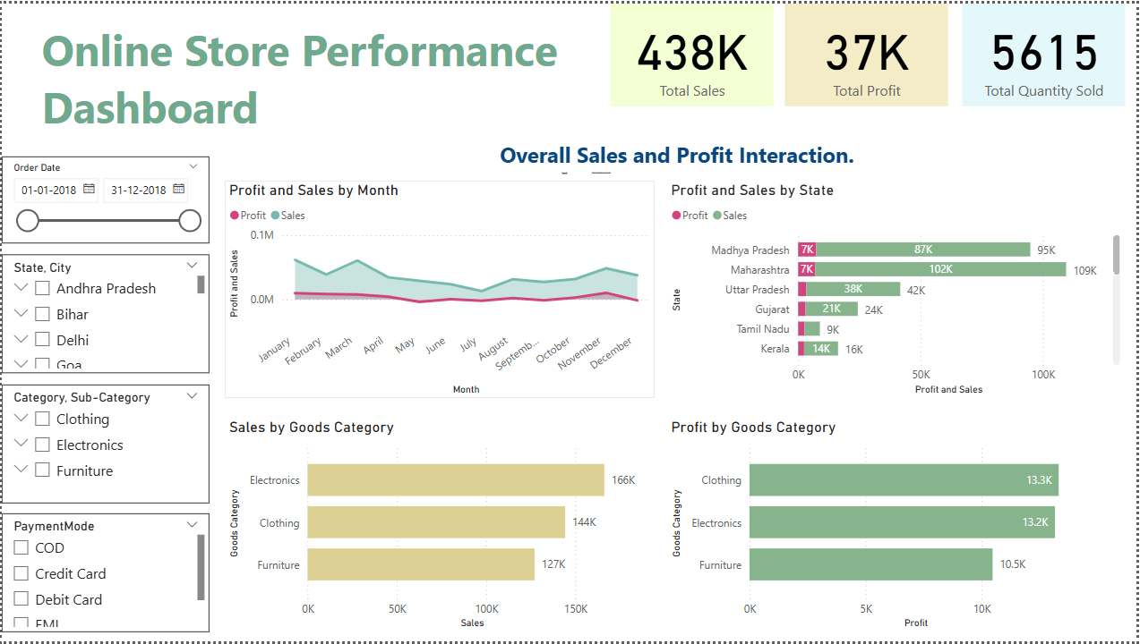
Online Store Performance Dashboard

Slide 3
Online Store Performance Dashboard
﻿﻿Profit and total Sales are positively correlated with each other.﻿﻿
The online store recorded a total sales value of ₹438K during the year.
The total profit generated was ₹37K, reflecting a moderate margin.
A total of 1500 orders were placed across all product categories.
The store sold a combined 5615 items in total quantity.
Cash on Delivery (COD) was the most popular payment method, used in 35% of transactions.
At 10253, November had the highest Profit and was 374.88% higher than May, which had the lowest Profit at -3730.﻿﻿
﻿﻿﻿﻿Sales and Profit diverged the most when the Month was March, when Sales were 52901 higher than Profit.﻿﻿
﻿﻿Electronics had the highest Sales at 166267, followed by Clothing at 144323 and Furniture at 127181.﻿﻿

Slide 4
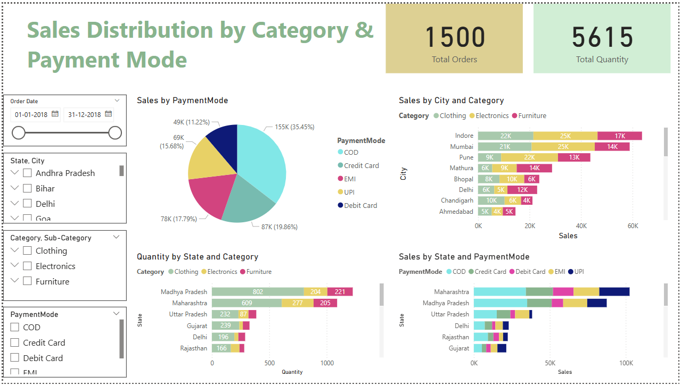
Online Store Performance Dashboard

Slide 5
Online Store Performance Dashboard
The analysis reveals that Electronics emerged as the top-performing product category in terms of sales, contributing approximately ₹166K, while Clothing led in profitability with a profit of around ₹13.3K.
From a regional perspective, Maharashtra topped the sales chart with ₹102K, followed closely by Madhya Pradesh and Uttar Pradesh, which also showed strong performance.
Among cities, Indore, Mumbai, and Pune stood out as the highest contributors to overall sales, demonstrating consistent demand across multiple product categories.
Popular Payment Modes:
Cash on Delivery (COD): 35% of total sales
Credit Card: 20%
EMI: 18%
Category Trends Across Cities:
Clothing and Electronics are the most popular categories across all major cities
Regional Insights:
Madhya Pradesh and Maharashtra reported the highest order quantities, indicating strong market demand

Slide 6
Thank you
Shantanu Kadam
k.shantanu5951@gmail.com

